Slide 1
AI-acoustic
Information and Communication Technology
Syu-Siang Wang
Research Center for Information Technology Innovation, Academia Sinica
2020/7/6
Notes:
1
Good morning everyone. My name is SyuSiangWang. This is my title. We proposed a method to improve the system performance of DDAE-based speech enhancement.

Slide 2
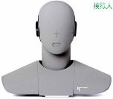
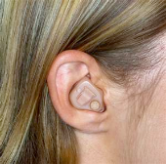
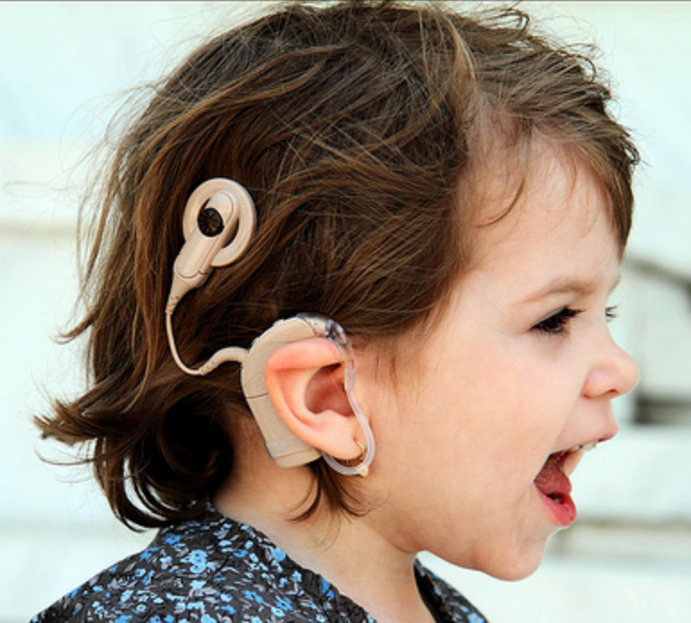
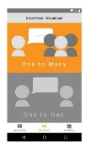
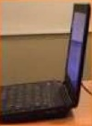

Research topics
SP
Input
Output
Speech signal processing
Single-channel
Multi-channel
Application
$$⋮$$
human
Compression
Noise robust feature for ASR
Code excitation linear prediction
Biomedical signal
Brainwave
Vocoder speech
health
machine

Slide 3
Research topics
SP
Input
Output
Speech signal processing
Single-channel
Multi-channel
Application
$$⋮$$
human
Compression
Noise robust feature for ASR
Code excitation linear prediction
Biomedical signal
Brainwave
Vocoder speech
health
machine

Slide 4
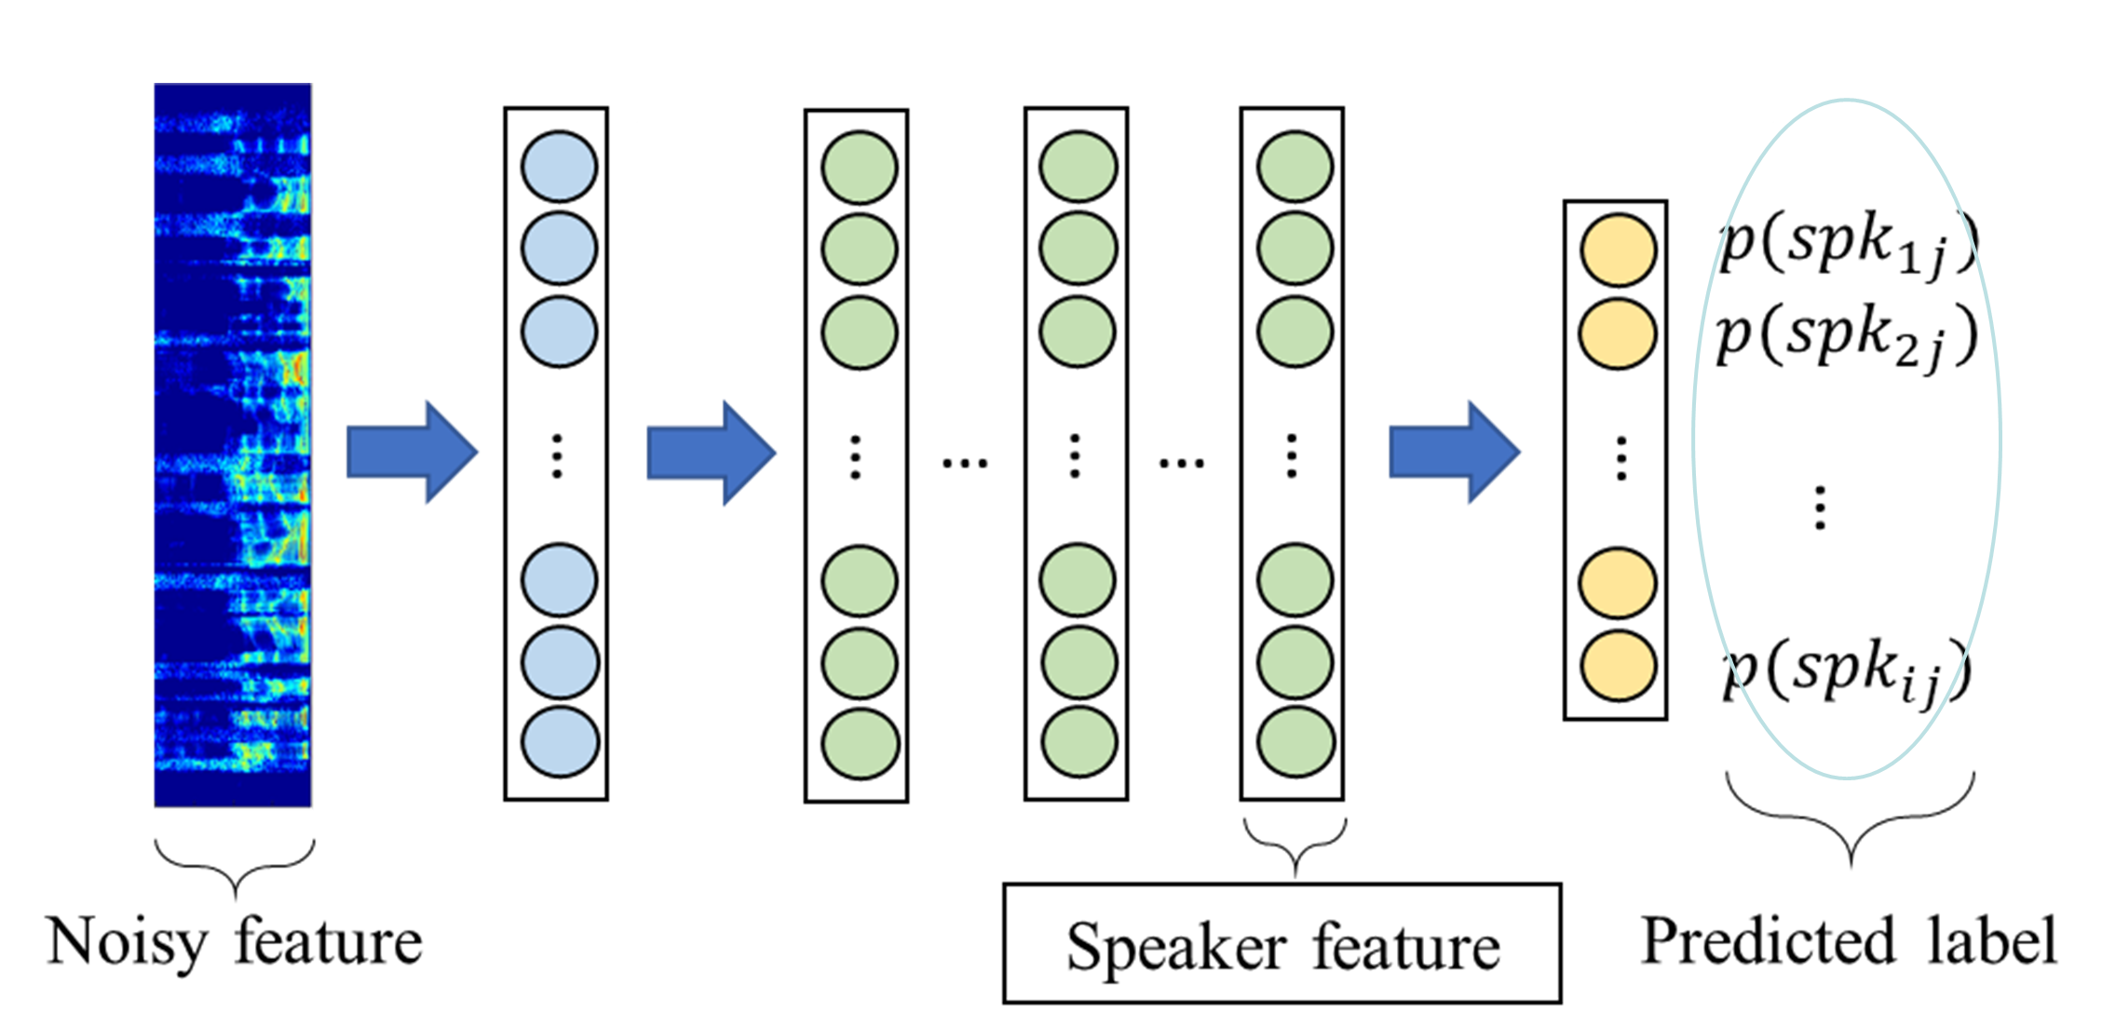



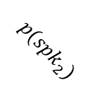
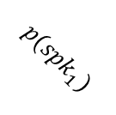


Speech signal processing
Single channel SE
Clean
SE system
Clean speech
Auxiliary input
1.
Speaker
Speaker label
$$p({spk}_{2})$$
$$p({spk}_{N})$$
2.
BCM
$$p({spk}_{1})$$
Noisy@0dB(baby crying)
Noisy
Clean
$$\text{FCN}$$
Speaker feature
1.
Speaker
BCM
3.
口內電訊號
2.
BCM
Reverb
Clean
$$\text{HDDAE}$$
FE
Input noisy
3.
口內電訊號
Elects.

Slide 5
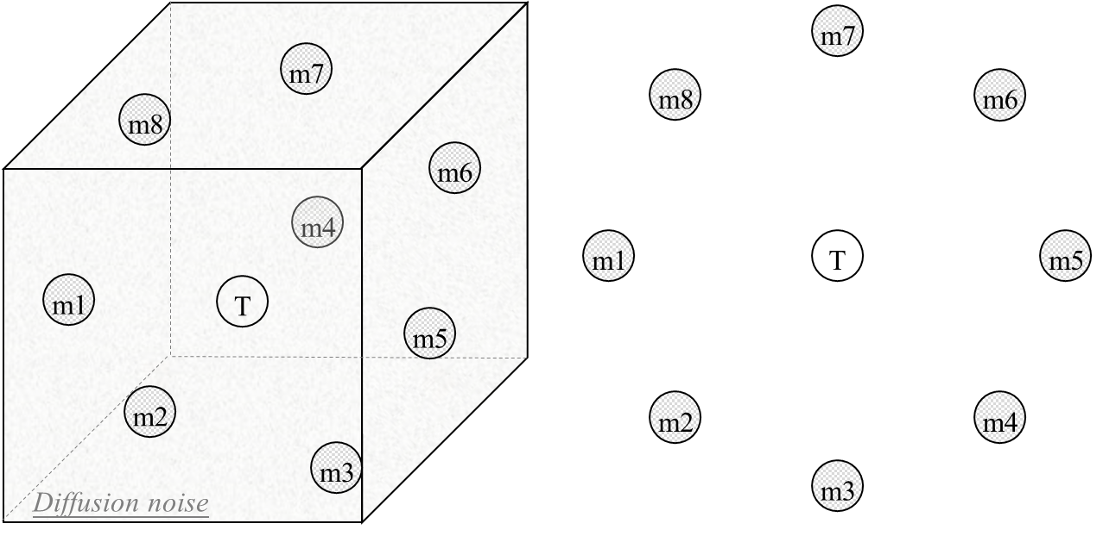
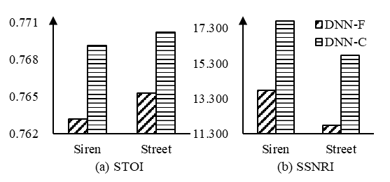
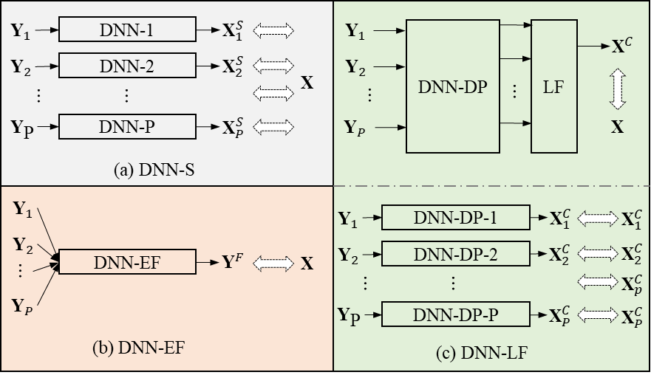
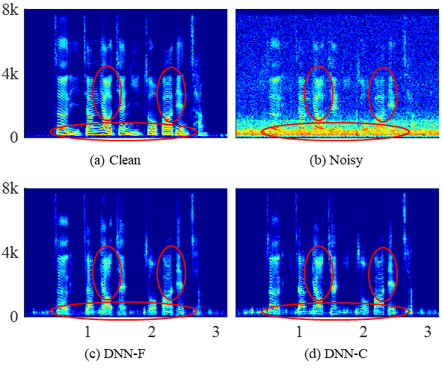
Speech signal processing
multi channel SE
 | DNN-S | DNN-EF | DNN-LF
STOI | 0.678 | 0.764 | 0.770
SSNRI | 11.464 | 12.760 | 16.729
DNN-EF
DNN-LF
DNN-EF
DNN-LF

Slide 6
Research topics
SP
Input
Output
Speech signal processing
Single-channel
Multi-channel
Application
$$⋮$$
human
Compression
Noise robust feature for ASR
Code excitation linear prediction
Biomedical signal
Brainwave
Vocoder speech
health
machine

Slide 7
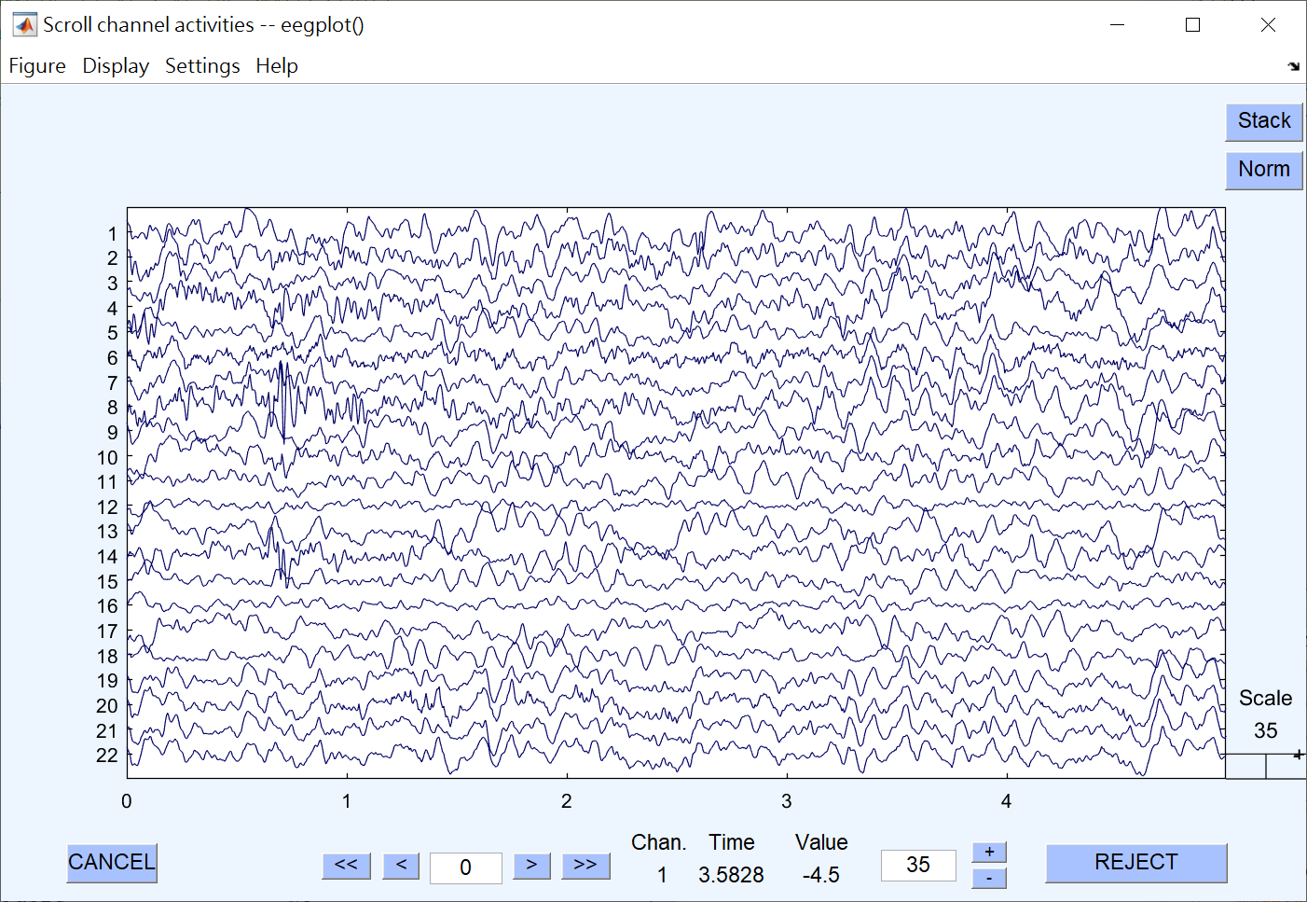
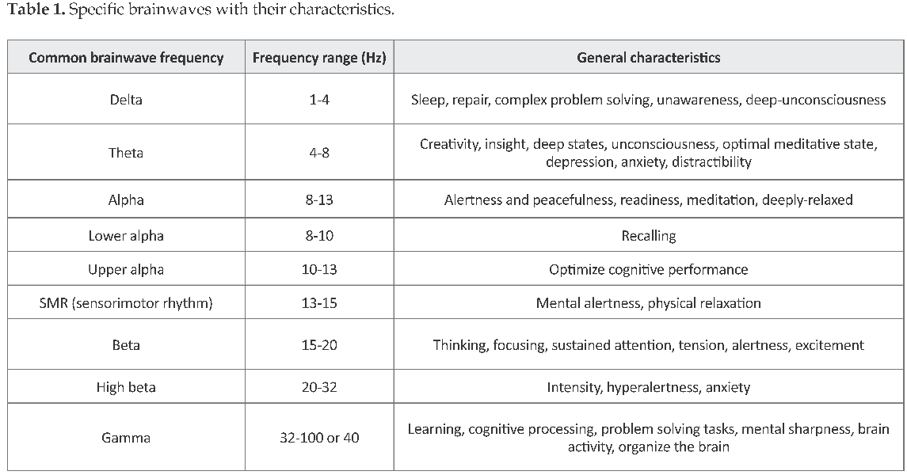
Biomedical signal
Brainwave
Clean
Marzbani, H., Marateb, H. R., & Mansourian, M. (2016). Neurofeedback: A Comprehensive Review on System Design, Methodology and Clinical Applications. Basic and clinical neuroscience, 7(2), 143–158.
Age prediction
Pred_EEG_Age
[17, 6, 5, 10, 5, 17, 5, 17, 14, 13, 12, 4, 11, 9, 11, 7]
True_EEG_Age
[22, 6, 5, 10, 4, 14, 8, 17, 14, 12, 15, 5, 13, 7, 13, 3]
Age
(20yr/12y3m/6y)

Slide 8
Research topics
SP
Input
Output
Speech signal processing
Single-channel
Multi-channel
Application
$$⋮$$
human
Compression
Noise robust feature for ASR
Code excitation linear prediction
Biomedical signal
Brainwave
Vocoder speech
health
machine

Slide 9
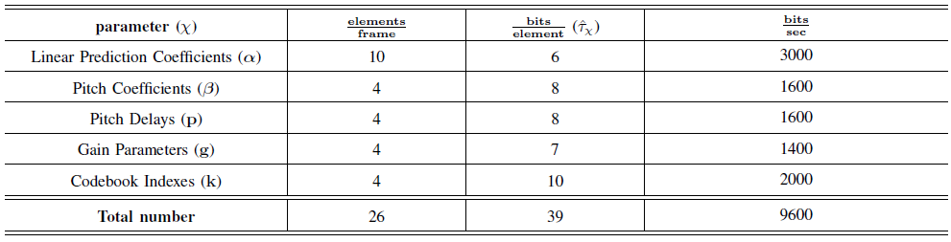
Research topics
Compression
Encoder
Decoder
CELP
encoder
CELP
decoder
Deep-learning model
Parameter pruning
Parameter reconstruction
<- here ->
Input
Data transmission or storage
Output
here ->
Y. Lo, S. Wang, Y. Tsao and S. Peng, "A Pruned-CELP Speech Codec Using Denoising Autoencoder with Spectral Compensation for Quality and Intelligibility Enhancement," in Proc. AICAS, pp. 150-151, 2019.

